Slide 1
MATH6077 – Discrete Mathematics
Week 01 - Logic

Slide 2
Propositional Logic Introduction
The rules of logic give precise meaning to mathematical statements
The importance of logic in understanding mathematical reasoning
Logic has numerous applications to computer science.
Design of computer circuits,
The construction of computer programs,
The verification of the correctness of programs, and in many other ways

Slide 3

Propositions

Slide 4
Propositions
A proposition is a declarative sentence (that is, a sentence that declares a fact) that is either true or false, but not both.
Example :
1. Washington, D.C., is the capital of the
United States of America. (T)
2. Toronto is the capital of Canada. (F)
3. 1 + 1 = 2. (T)
4. 2 + 2 = 3. (F)

Slide 5

Propositions
Consider the following sentences :
1. What time is it?
(not propositions , not declarative sentences)
2. Read this carefully.
(not propositions, not declarative sentences)
3. x + 1 = 2.
(not propositions - neither true nor false)
4. x + y = z.
(not propositions - neither true nor false)

Slide 6
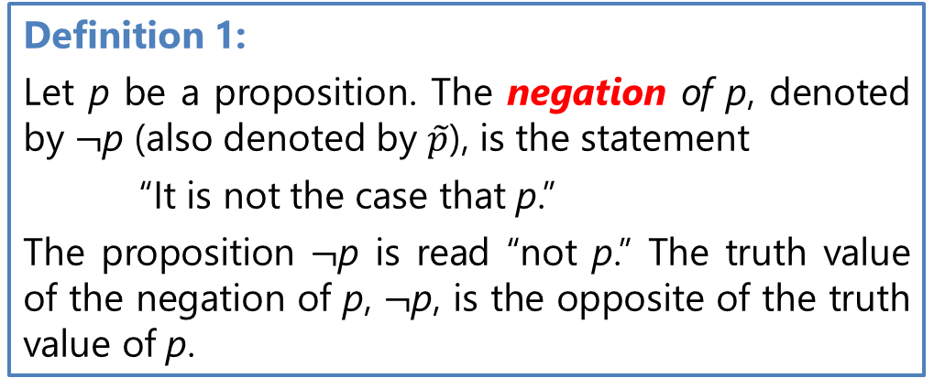
Logical Operators
Negation
Example : Find the negation of the proposition
“Michael’s PC runs Linux”
Solution : The negation is :
“Michael’s PC does not run Linux.”

Slide 7
Logical Operators
Conjunction
Definition 2:
Let p and q be propositions. The conjunction of p and q, denoted by p ∧ q, is the proposition “p and q.” The conjunction p ∧ q is true when both p and q are true and is false otherwise.
Example : Find the conjunction of the propositions p and q where
p : “Rebecca’s PC has more than 16 GB free hard disk space”
q : “The processor in Rebecca’s PC runs faster than 1 GHz.”
Solution : The conjunction is :
“Rebecca’s PC has more than 16 GB free hard disk space,
and its processor runs faster than 1 GHz.”

Slide 8
Logical Operators
Disjunction
Definition 3:
Let p and q be propositions. The disjunction of p and q, denoted by p ∨ q, is the proposition “p or q.” The disjunction p ∨ q is false when both p and q are false and is true otherwise.
Example : What is the disjunction of the propositions p and q,
p : “Rebecca’s PC has more than 16 GB free hard disk space”
q : “The processor in Rebecca’s PC runs faster than 1 GHz.”
Solution : The disjunction is :
“Rebecca’s PC has at least 16 GB free hard disk space, or
the processor in Rebecca’s PC runs faster than 1 GHz.”

Slide 9
Logical Operators
Exclusive Or
Definition 4:
Let p and q be propositions. The exclusive or of p and q, denoted by p ⊕ q (or pXOR q), is
the proposition that is true when exactly one of p and q is true and is false otherwise.
Example : Let
p : “A student can have a salad with dinner” and
q : “A studentcan have soup with dinner,”
What is p ⊕ q, the exclusive or of p and q?
Solution :
“A student can have soup or a salad with dinner,” (but not both)

Slide 10
Conditional Statements

Slide 11
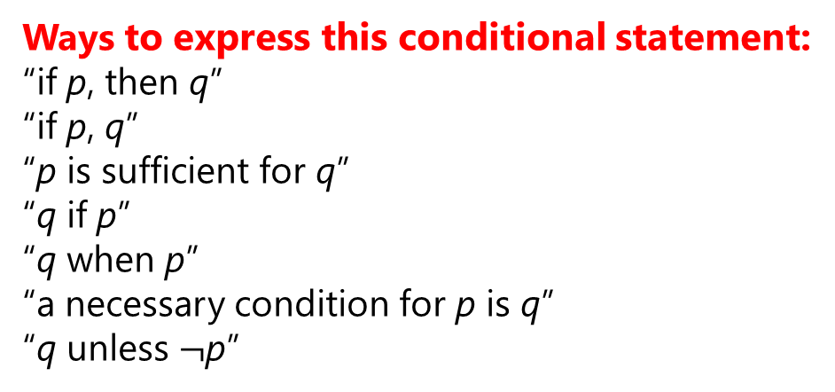
Conditional Statements
Definition 5:
Let p and q be propositions. The conditional statement p → q is the proposition “if p, then q.” The conditional statement p → q is false when p is true and q is false, and true otherwise. In the conditional statement p → q, p is called the hypothesis (or antecedent or premise) and q is called the conclusion (or consequence).
Conditional Statement
Ways to express this conditional statement:
“if p, then q”
“if p, q”
“p is sufficient for q”
“q if p”
“q when p”
“a necessary condition for p is q”
“q unless $¬$p”

Slide 12
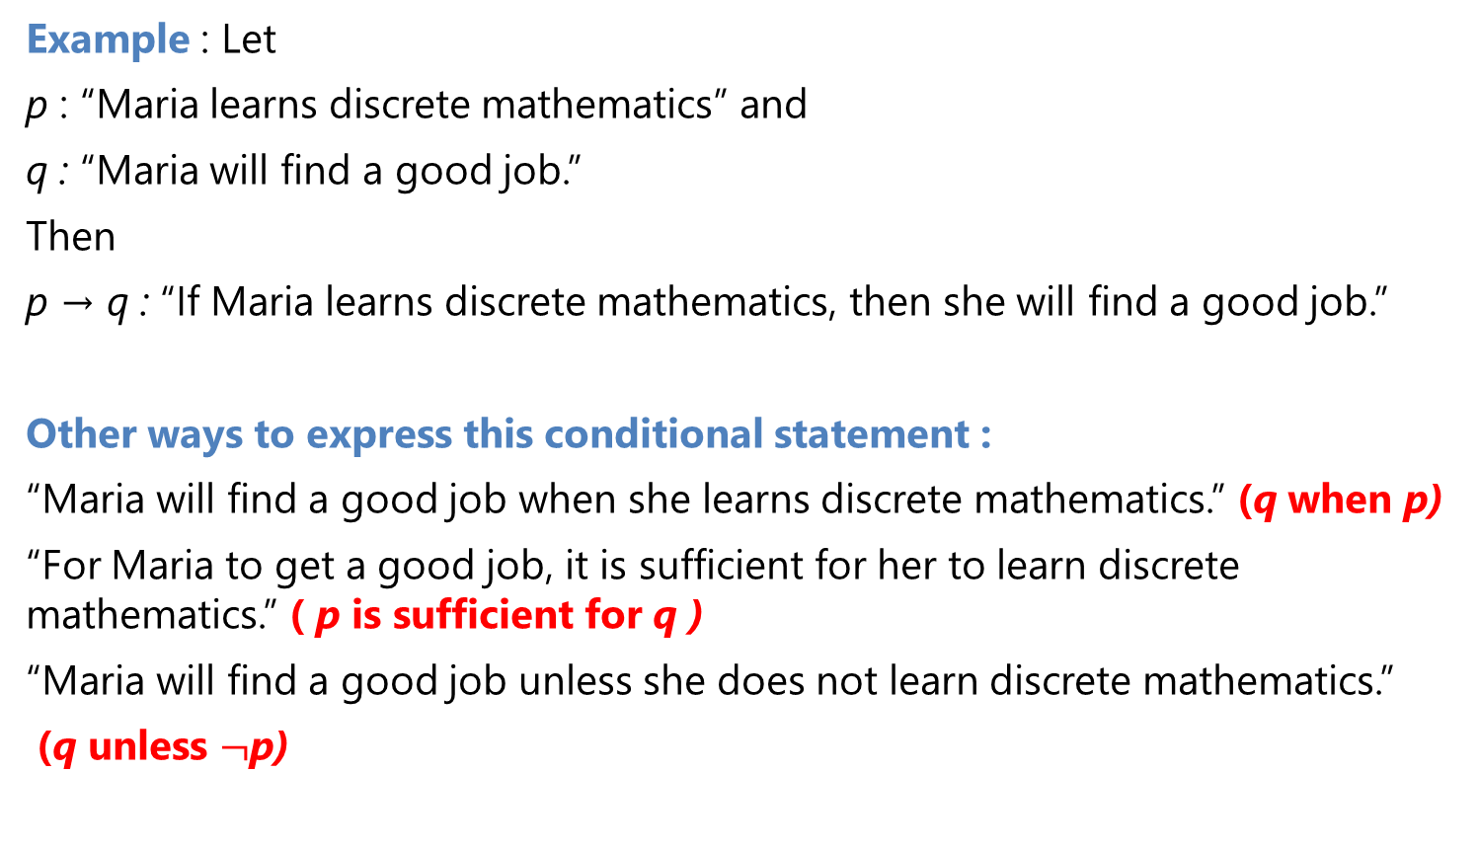
Conditional Statements
Example : Let
p : “Maria learns discrete mathematics” and
q : “Maria will find a good job.”
Then
p → q : “If Maria learns discrete mathematics, then she will find a good job.”
Other ways to express this conditional statement :
“Maria will find a good job when she learns discrete mathematics.” (q when p)
“For Maria to get a good job, it is sufficient for her to learn discrete mathematics.” ( p is sufficient for q )
“Maria will find a good job unless she does not learn discrete mathematics.”
(q unless $¬$p)

Slide 13
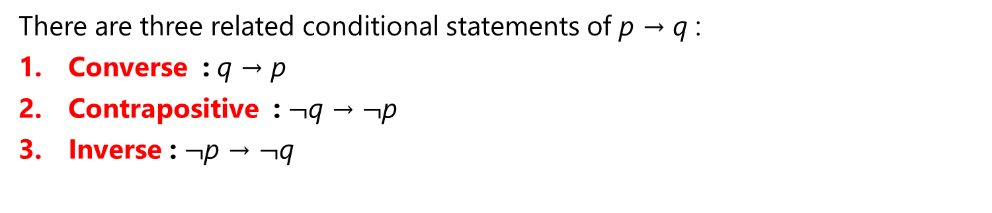
Conditional Statements
There are three related conditional statements of p → q :
Converse : q → p
Contrapositive : $¬$q → $¬$p
Inverse : $¬$p → $¬$q
Example :
Find the contrapositive, the converse, and the inverse of the conditional statement
“The home team wins whenever it is raining.”
Solution :
p → q : “If it is raining, then the home team wins.”
Contrapositive : “If the home team does not win, then it is not raining.”
Converse : “If the home team wins, then it is raining.”
Inverse : “If it is not raining, then the home team does not win.”

Slide 14
Biconditional Statements
Definition 6 :
Let p and q be propositions. The biconditional statement p ↔ q is the proposition “p if and only if q.” The biconditional statement p ↔ q is true when p and q have the same truth values, and is false otherwise. Biconditional statements are also called bi-implications.
Biconditional Statement
Ways to express this Biconditional statement:
“p is necessary and sufficient for q”
“if p then q, and conversely”
“p iff q.”
“p exactly when q.”

Slide 15
Biconditional Statements
Example : Let
p : “You can take the flight,” and
q : “You buy a ticket.”
Then
p ↔ q: “You can take the flight if and only if you buy a ticket.”
This statement is true if :
p and q are either both true or both false, that is, if you buy a ticket and
can take the flight or if you do not buy a ticket and you cannot take the flight.
It is false when :
you do not buy a ticket, but you can take the flight (such as when you get a free trip) and when you buy a ticket but you cannot take the flight (such as when the airline bumps you).

Slide 16
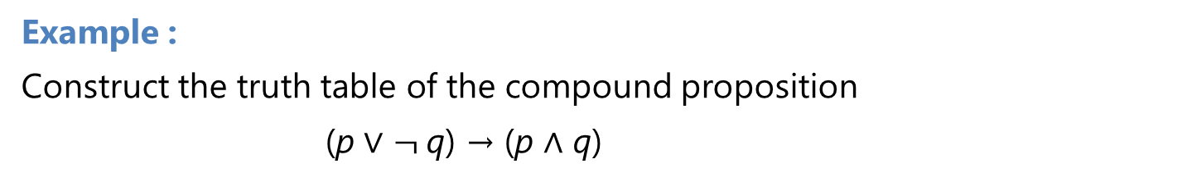
Truth Tables of Compound Propositions
Example :
Construct the truth table of the compound proposition
(p ∨ $¬$q) → (p ∧ q)
Solution :
Truth value

Slide 17
Precedence of Logical Operators
The precedence levels of the logical operators :
Example :
p ∨ q ∧ r means p ∨ (q ∧ r)
p ∧ q ∨ r means (p ∧ q) ∨ r
p → q ∨ r means p → (q ∨ r)
p ∨ q → r means (p ∨ q) → r

Slide 18
Logic and Bit Operations
Computers represent information using bits.
A bit is a symbol with two possible values, namely,0 (zero) and 1 (one).
The word bit comes from binary digit, because zeros and ones are the digits used in binary representations of numbers.
A bit can be used to represent a truth value, because there are two truth values, namely, true and false. As is customarily done, we will use a 1 bit
to represent true and a 0 bit to represent false.
A variable is called a Boolean variable if its value is either true or false.

Slide 19
Logic and Bit Operations
Definition 7 :
A bit string is a sequence of zero or more bits. The length of this string is the number of bits in the string.
Example : 101010011 is a bit string of length nine.
The bitwise OR, bitwise AND, and bitwise XOR of two strings of the same length to be the strings that have as their bits the OR, AND, and XOR of the corresponding bits in the two strings, respectively.
The symbols ∨, ∧, and ⊕ to represent the bitwise OR, bitwise AND, and bitwise XOR operations

Slide 20
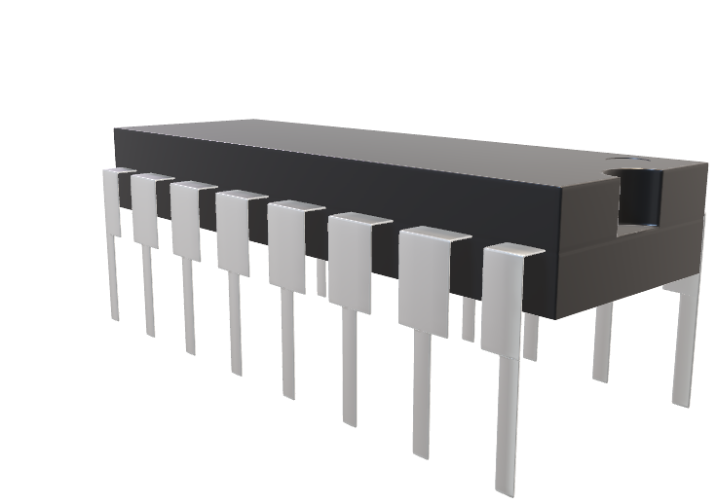
Logic and Bit Operations
Example :
Find the bitwise OR, bitwise AND, and bitwise XOR of the bit strings
01 1011 0110 and 11 0001 1101.
Solution:
01 1011 0110
11 0001 1101
11 1011 1111 bitwise OR
01 0001 0100 bitwise AND
10 1010 1011 bitwise XOR

Slide 21
Propositional Equivalences

Slide 22
Compound proposition
Compound proposition : an expression formed from propositional variables using logical operators
Definisi 1.
A compound proposition that is always true, no matter what the truth values of the propositional variables that occur in it, is called a tautology. A compound proposition that is always false is called a contradiction. A compound proposition that is neither a tautology nor a contradiction is called a contingency.
Example :
Tautology
Contradiction

Slide 23
Logical Equivalences
Logically equivalent. : Compound propositions that have the same truth values in all possible cases.
Definisi 2.
The compound propositions p and q are called logically equivalent if p ↔ q is a tautology. The notation p ≡ q (p ⇔ q) denotes that p and q are logically equivalent.
Example : $¬$(p ∨ q) and $¬$p ∧ $¬$q are logically equivalent.

Slide 24
Logical Equivalences Identities

Slide 25
Logical Equivalences

Slide 26
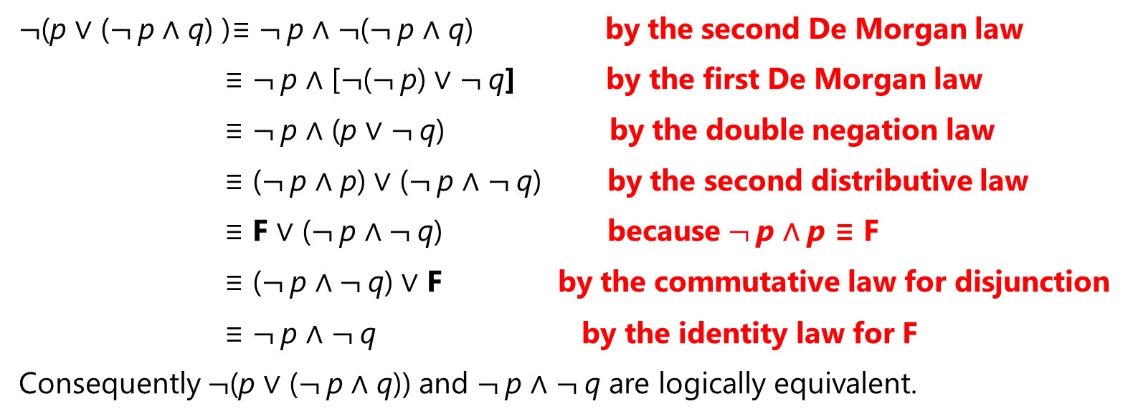
Constructing New Logical Equivalences
Example : Show that $¬$(p ∨ ($¬$p ∧ q)) and $¬$p ∧ $¬$q are logically equivalent by developing a series of logical equivalences.
Solution :
$¬$(p ∨ ($¬$p ∧ q) )≡ $¬$p ∧ $¬$($¬$p ∧ q) by the second De Morgan law
≡ $¬$p ∧ [$¬$($¬$p) ∨ $¬$q] by the first De Morgan law
≡ $¬$p ∧ (p ∨ $¬$q) by the double negation law
≡ ($¬$p ∧ p) ∨ ($¬$p ∧ $¬$q) by the second distributive law
≡ F ∨ ($¬$p ∧ $¬$q) because $¬$p ∧ p ≡ F
≡ ($¬$p ∧ $¬$q) ∨ F by the commutative law for disjunction
≡ $¬$p ∧ $¬$q by the identity law for F
Consequently $¬$(p ∨ ($¬$p ∧ q)) and $¬$p ∧ $¬$q are logically equivalent.

Slide 27
Rules of Inference

Slide 28
Rules of Inference
Proofs in mathematics are valid arguments that establish the truth of mathematical statements.
By an argument, we mean a sequence of statements that end with a conclusion. By valid, we mean that the conclusion, or final statement of the argument, must follow from the truth of the preceding statements, or premises, of the argument.
An argument is valid if and only if it is impossible for all the premises to be true and the conclusion to be false.
Fallacies : some common forms of incorrect reasoning which lead to invalid arguments.

Slide 29
Valid Arguments in Propositional Logic
Determine whether this is a valid argument !
“If you have a current password, then you can log onto the network.”
“You have a current password.”
Therefore,
“You can log onto the network.”
Solution :
Let p : “You have a current password” and
q : “You can log onto the network.”
Then, the argument has the form
p → q
p
∴ q
where ∴ is the symbol that denotes “therefore.”
Because the statement
((p→q) ∧ p) → q is a tautology so this argument is valid.

Slide 30
Valid Arguments in Propositional Logic
Definition :
An argument in propositional logic is a sequence of propositions. All but the final proposition in the argument are called premises and the final proposition is called the conclusion. An argument is valid if the truth of all its premises implies that the conclusion is true. An argument form in propositional logic is a sequence of compound propositions involving propositional variables. An argument form is valid if no matter which particular propositions are substituted for the propositional variables in its premises, the conclusion is true if the premises are all true.
Remark: From the definition of a valid argument form we see that the argument form with premises p1, p2,…, pn and conclusion q is valid exactly when (p1 ∧ p2 ∧⋯∧ pn) → q is a tautology.

Slide 31
Rules of Inference

Slide 32
Rules of Inference

Slide 33
Using Rules of Inference to Build Arguments
Example :
Show that the premises :
“It is not sunny this afternoon and it is colder than yesterday,”
“We will go swimming only if it is sunny,”
“If we do not go swimming, then we will take a canoe trip,” and
“If we take a canoe trip, then we will be home by sunset”
lead to the conclusion :
“We will be home by sunset.”
Solution:
Let p : “It is sunny this afternoon,”
q : “It is colder than yesterday,”
r : “We will go swimming,”
s : “We will take a canoe trip,” and
t : “We will be home by sunset.”
∴ The conclusion is simply t.

Slide 34
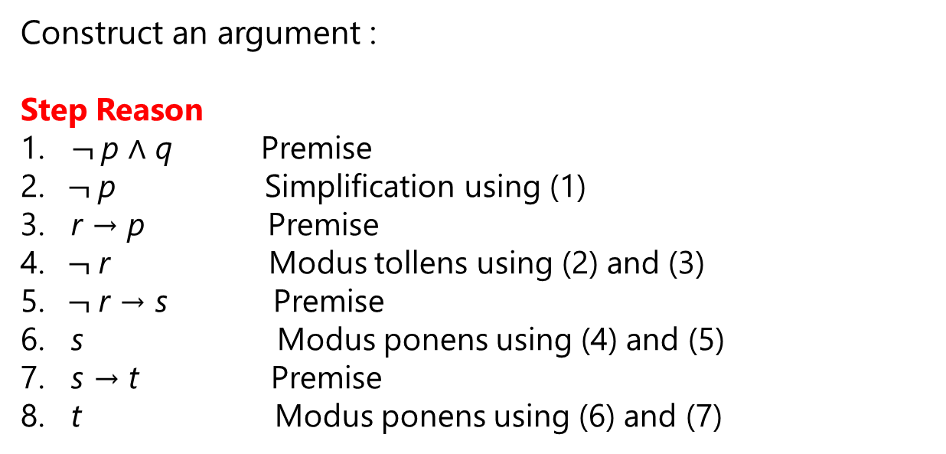
Using Rules of Inference to Build Arguments
Construct an argument :
Step Reason
1. $¬$p ∧ q Premise
2. $¬$p Simplification using (1)
3. r → p Premise
4. $¬$r Modus tollens using (2) and (3)
5. $¬$r → s Premise
6. s Modus ponens using (4) and (5)
7. s → t Premise
8. t Modus ponens using (6) and (7)
So, each of the four hypotheses is true, the conclusion is also true

Slide 35
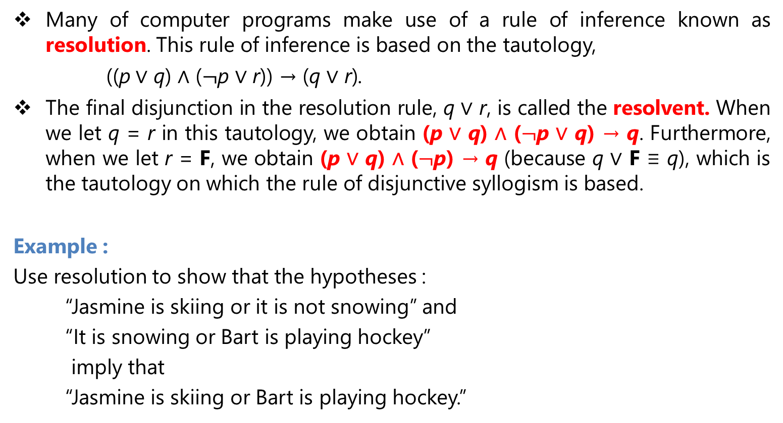
Resolution
Many of computer programs make use of a rule of inference known as resolution. This rule of inference is based on the tautology,
((p ∨ q) ∧ ($¬$p ∨ r)) → (q ∨ r).
The final disjunction in the resolution rule, q ∨ r, is called the resolvent. When we let q = r in this tautology, we obtain (p ∨ q) ∧ ($¬$p ∨ q) → q. Furthermore, when we let r = F, we obtain (p ∨ q) ∧ ($¬$p) → q (because q ∨ F ≡ q), which is the tautology on which the rule of disjunctive syllogism is based.
Example :
Use resolution to show that the hypotheses :
“Jasmine is skiing or it is not snowing” and
“It is snowing or Bart is playing hockey”
imply that
“Jasmine is skiing or Bart is playing hockey.”

Slide 36
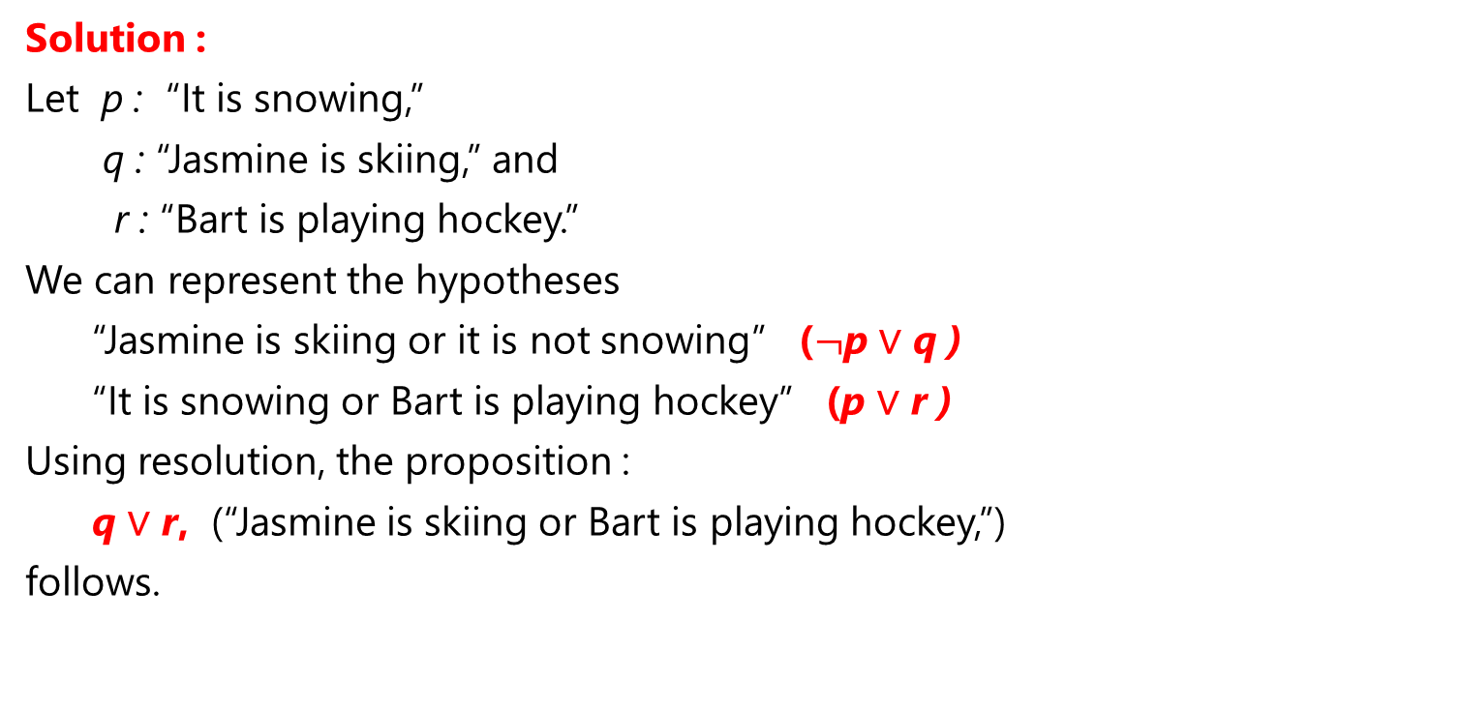
Resolution
Solution :
Let p : “It is snowing,”
q : “Jasmine is skiing,” and
r : “Bart is playing hockey.”
We can represent the hypotheses
“Jasmine is skiing or it is not snowing” ($¬$p ∨ q )
“It is snowing or Bart is playing hockey” (p ∨ r )
Using resolution, the proposition :
q ∨ r, (“Jasmine is skiing or Bart is playing hockey,”)
follows.

Slide 37
Fallacies
Fallacy of affirming the conclusion.
The proposition ((p → q) ∧ q) → p is not a tautology, because it is false when p is false and q is true. However, there are many incorrect arguments that treat this as a tautology.
Example :
Is the following argument valid?
If you do every problem in this book, then you will learn discrete mathematics. You learned discrete mathematics.
Therefore, you did every problem in this book.
Solution :
Let p : “You did every problem in this book.”
q : “You learned discrete mathematics.”
This is incorrect reasoning called the fallacy of affirming the conclusion.
p → q
q
p ?

Slide 38
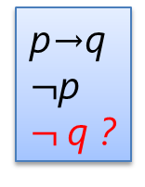
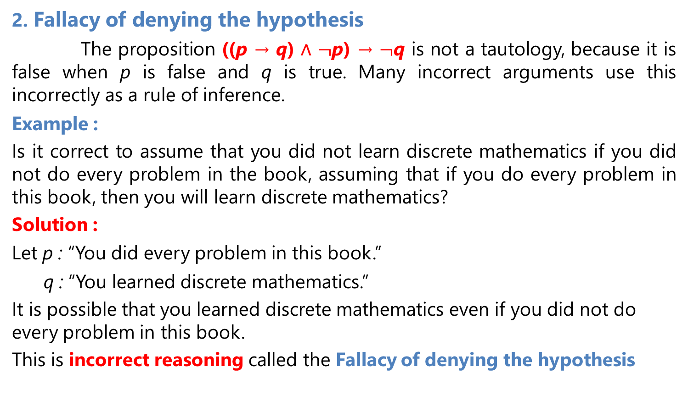
Fallacies
2. Fallacy of denying the hypothesis
The proposition ((p → q) ∧ $¬$p) → $¬$q is not a tautology, because it is false when p is false and q is true. Many incorrect arguments use this incorrectly as a rule of inference.
Example :
Is it correct to assume that you did not learn discrete mathematics if you did not do every problem in the book, assuming that if you do every problem in this book, then you will learn discrete mathematics?
Solution :
Let p : “You did every problem in this book.”
q : “You learned discrete mathematics.”
It is possible that you learned discrete mathematics even if you did not do every problem in this book.
This is incorrect reasoning called the Fallacy of denying the hypothesis
p→q
$¬$p
$¬$q ?

Slide 39
Applications of Propositional Logic

Slide 40

Applications of Propositional Logic
Translating English Sentences
Example :
How can this English sentence be translated into a logical expression?
“You can access the Internet from campus only if you are a computer science major or you are not a freshman.”
Solution :
let
a : “You can access the Internet from campus”
c : “You are a computer science major”
f : “You are a freshman”
this sentence can be represented as
a → (c ∨ $¬$f )

Slide 41
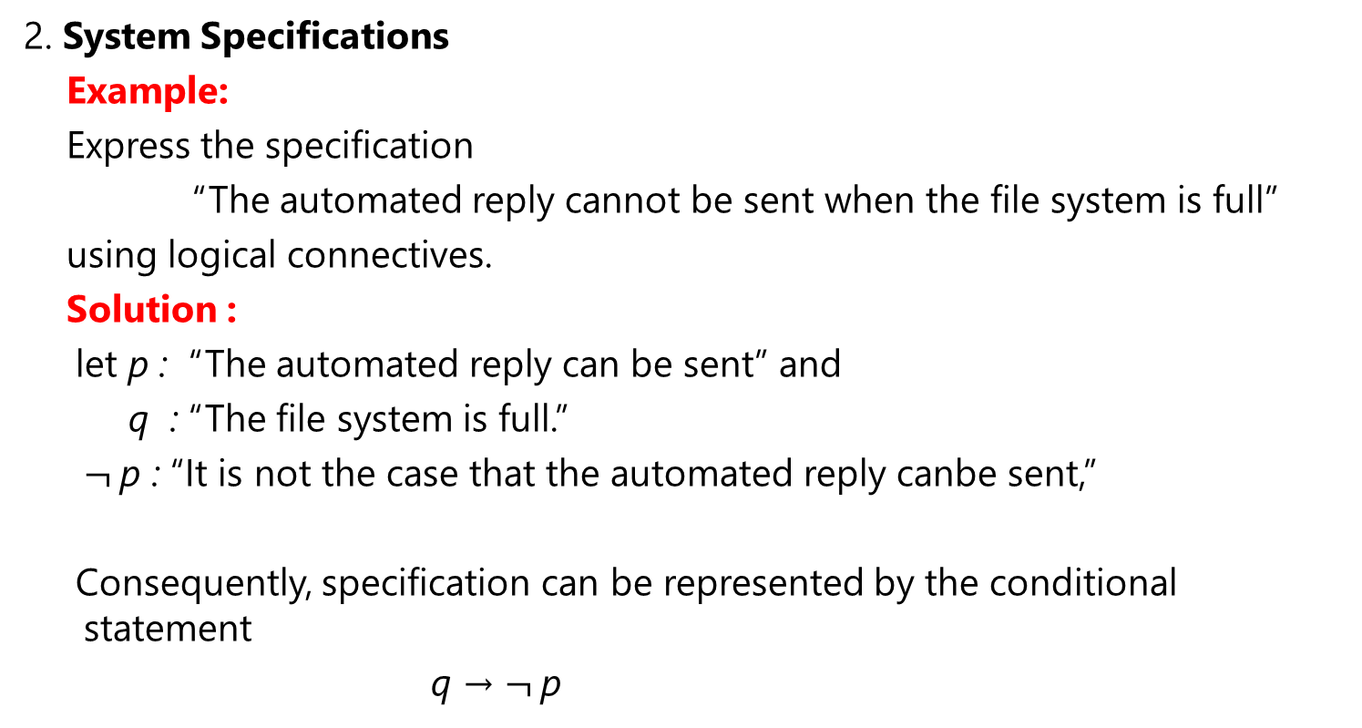
Applications of Propositional Logic
2. System Specifications
Example:
Express the specification
“The automated reply cannot be sent when the file system is full”
using logical connectives.
Solution :
let p : “The automated reply can be sent” and
q : “The file system is full.”
$¬$p : “It is not the case that the automated reply canbe sent,”
Consequently, specification can be represented by the conditional statement
q → $¬$p

Slide 42
Applications of Propositional Logic
3. Boolean Searches
Example:
Web Page Searching : using Boolean searching to find Web pages about universities in New Mexico.
we can look for pages matching at search engines :
- NEW AND MEXICO AND UNIVERSITIES
- “NEW MEXICO” AND UNIVERSITIES.

Slide 43
Applications of Propositional Logic
4. Logic Puzzles
Example :
As a reward for saving his daughter from pirates, the King has given you the opportunity to win a treasure hidden inside one of three trunks. The two trunks that do not hold the treasure are empty. To win, you must select the correct trunk :
Trunks 1 and 2 are each inscribed with the message “This trunk is empty,” and
Trunk 3 is inscribed with the message “The treasure is in Trunk 2.”
The Queen, who never lies, tells you that only one of these inscriptions is true, while the other two are wrong. Which trunk should you select to win?

Slide 44
Logic Puzzles
Solution :
Let pi be the proposition that the treasure is in Trunk i, for i = 1, 2, 3. To translate into propositional logic the Queen’s statement that exactly one of the inscriptions is true, we observe that the inscriptions on Trunk 1, Trunk 2, and Trunk 3, are ￢p1, ￢p2, and p2, respectively. So, her statement can be translated to
(￢p1 ∧ ￢(￢p2) ∧ ￢p2) ∨ (￢(￢p1) ∧ ￢p2 ∧ ￢p2) ∨ (￢(￢p1) ∧ ￢(￢p2) ∧ p2)).
≡ (p1 ∧ ￢p2) ∨ (p1 ∧ p2).
≡ p1 ∧ (￢p2 ∨ p2).
≡ p1 ∧ T
≡ p1
So the treasure is in Trunk 1 (that is, p1 is true), and p2 and p3 are false; and the inscription on Trunk 2 is the only true one.

Slide 45
Applications of Propositional Logic
5. Logic Circuits
A logic circuit (or digital circuit) receives input signals p1, p2,…, pn, each a bit [either 0 (off) or 1 (on)], and produces output signals s1, s2,…, sn, each a bit.
Complicated digital circuits can be constructed from three basic circuits, called gates, that is NOT gate, OR gate, and AND gate.

Slide 46
Logic Circuits
Combinations of these three basic gates called A combinatorial circuit.
Example 1 : (p ∧ ￢q) ∨ ￢r

Slide 47
A combinatorial circuit.
Example 2 :
(p∨￢r) ∧ (￢p ∨ (q∨￢r))

Slide 48
Boolean Algebra

Slide 49
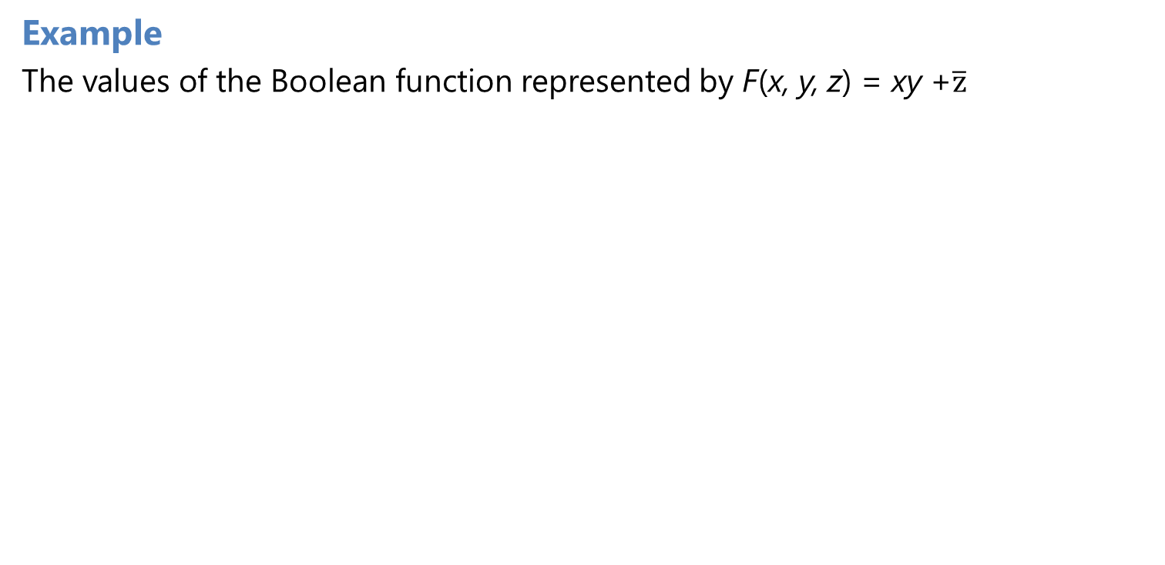
Boolean expressions
Example
The values of the Boolean function represented by F(x, y, z) = xy +$\overline{\text{z}}$

Slide 50
Identities of Boolean Algebra

Slide 51
Identities of Boolean Algebra

Slide 52
Identities of Boolean Algebra
Example 1 :
Show that the distributive law x(y + z) = xy + xz is valid.
Solution :
The identity holds because the last two columns of the table agree.

Slide 53
Identities of Boolean Algebra
Example 2 :
Prove the absorption law x(x + y) = x using the other identities of Boolean algebra
Solution:
x(x + y) = (x + 0)(x + y) Identity law for the Boolean sum
= x + 0 ⋅ y Distributive law of the Boolean sum over the
Boolean product
= x + y ⋅ 0 Commutative law for the Boolean product
= x + 0 Domination law for the Boolean product
= x Identity law for the Boolean sum.

Slide 54
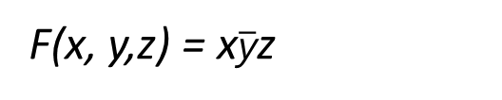
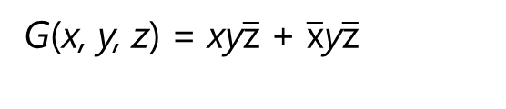
Representing Boolean Functions
1. Sum-of-Products Expansions / disjunctive normal form
Example 1 :
Find Boolean expressions that represent the functions F(x, y, z) and G(x, y, z), which are given in Table below
Solution :
F(x, y,z) = x$\overline{\text{y}}$z
G(x, y, z) = xy$\overline{\text{z}}$ + $\overline{\text{x}}$y$\overline{\text{z}}$

Slide 55
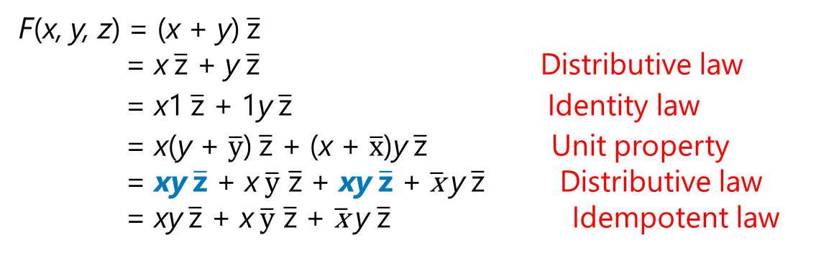
Representing Boolean Functions
1. Sum-of-Products Expansions / disjunctive normal form
Example 2 :
Find the sum-of-products expansion for the function F(x, y, z) = (x + y) $\overline{\text{z}}$
Solution :
a. Using Boolean identities
F(x, y, z) = (x + y) $\overline{\text{z}}$
= x $\overline{\text{z}}$ + y $\overline{\text{z}}$ Distributive law
= x1 $\overline{\text{z}}$ + 1y $\overline{\text{z}}$ Identity law
= x(y + $\overline{\text{y}}$) $\overline{\text{z}}$ + (x + $\overline{\text{x}}$)y $\overline{\text{z}}$ Unit property
= xy $\overline{\text{z}}$ + x $\overline{\text{y}}$ $\overline{\text{z}}$ + xy $\overline{\text{z}}$ + $\overline{\text{x}}$y $\overline{\text{z}}$ Distributive law
= xy $\overline{\text{z}}$ + x $\overline{\text{y}}$ $\overline{\text{z}}$ + $\overline{\text{x}}$y $\overline{\text{z}}$ Idempotent law

Slide 56
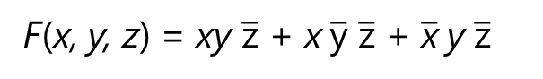
Representing Boolean Functions
Solution :
b. By determining the values of F for all possible values of the variables x, y, and z
This gives :
F(x, y, z) = xy $\overline{\text{z}}$ + x $\overline{\text{y}}$ $\overline{\text{z}}$ + $\overline{\text{x}}$y $\overline{\text{z}}$

Slide 57
Representing Boolean Functions

Slide 58
Representing Boolean Functions
The basic elements of circuits are called gates
The circuits that give output that depends only on the input, and not on the currentstate of the circuit. In other words, these circuits have no memory capabilities. Such circuits are called combinational circuits or gating networks.
Basic types of gates.

Slide 59
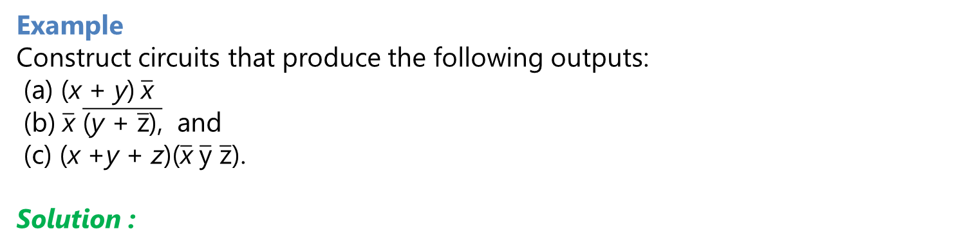
Combinations of Gates
Example
Construct circuits that produce the following outputs:
(a) (x + y) $\overline{\text{x}}$
(b) $\overline{\text{x}}$ $\overline{\text{(}\text{y} \text{+ }\overline{\text{z}}\text{),}}$ and
(c) (x +y + z)($\overline{\text{x}}$ $\overline{\text{y}}$ $\overline{\text{z}}$).
Solution :

Slide 60
Combinations of Gates

Slide 61
Examples of Circuits
Example 1 . Majority Voting
A committee of three individuals decides issues for an organization. Each individual votes either yes or no for each proposal that arises. A proposal is passed if it receives at least two yes votes. Design a circuit that determines whether a proposal passes.
Solution :
Let
x = 1 if the first individual votes yes,
y = 1 if the second individual votes yes,
z = 1 if the third individual votes yes,

Slide 62
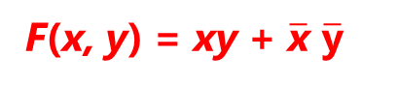
Examples of Circuits
Example 2 . A light controlled by two switches
Sometimes light fixtures are controlled by more than one switch. Circuits need to be designed so that flipping any one of the switches for the fixture turns the light on when it is off and turns the light off when it is on. Design circuits that accomplish this when there are two switches.
Solution :
Let
x = 1 when the first switch is closed
y = 1 when the second switch is closed
F(x, y) = 1 when the light is on
F(x, y) = 0 when the light is off
F(1, 1) = 1 (Decide that the light will be on when both switches are closed)
F(1, 0) = F(0, 1) = 0 (When one of the two switches is opened, the light goes off,
F(0, 0) = 1 (When the other switch is also opened, the light goes on)
F(x, y) = xy + $\overline{\text{x}}$ $\overline{\text{y}}$

Slide 63
A Circuit light controlled by two switches
Solution :

Slide 64
Adders
The circuit that has two output is called the half adder, namely, s and c, where s is the sum bit and c is the carry bit .
Example
Output for the half adder :

Slide 65
Karnaugh Map

Slide 66
Karnaugh Map
A Karnaugh map or K-map, for finding terms to combine for Boolean functions involving a relatively small number of variables
The method we will describe was introduced by Maurice Karnaugh in 1953. His method is based on earlier work by E.W. Veitch.
K-maps give us a visual method for simplifying sum-of-products expansions; they are not suited for mechanizing this process
A Karnaugh map has zero and one entries at different positions. Each position in a grid corresponds to a truth table entry.
Given a Boolean function described by a truth table or logic function, then:
Draw the Karnaugh Map for the function.
Use the information from a Karnaugh Map to determine the smallest sum-of-products function.

Slide 67
Karnaugh Map in Two Variables
There are four possible minterms in the sum-of-products expansion of a Boolean function in the two variables x and y.
A K-map for a Boolean function in these two variables consists of four cells, where a 1 is placed in the cell representing a minterm if this minterm is present in the expansion. Cells are said to be adjacent if the minterms that they represent differ in exactly one literal.
For instance, the cell representing is adjacent to the cells representing
and

Slide 68
Karnaugh Map in Two Variables
Example :
Find the K-maps for Boolean expression E that equal to :
Solution :
E = y
E =
E =

Slide 69
Karnaugh Map in three variables
Let α(x,y,z) be a sum of product Boolean expression such that minterm consists of three variables x,y,z. To define the K-map for α(x,y,z) , we consider the following table

Slide 70
Blocks in K-maps in three variables.

Slide 71
Karnaugh Map in three variables
Example :
Use K-maps to minimize these sum-of-products expansions

Slide 72
Karnaugh Map in three variables
Solution :

Slide 73
A K-map in four variables
Let α(x,y,z,w) be a sum
of product Boolean
expression such that
minterm consists of
three variables x,y,z,w.
To define the K-map
for α(x,y,z,w), we
consider the following
table

Slide 74
Blocks in K-maps in four variables.

Slide 75
A K-map in four variables
Example :
Use K-maps to simplify these sum-of-products expansions.

Slide 76
A K-map in four variables
Solution :

Slide 77
Reference
Kenneth H. Rosen, “ Discrete Mathematics and its Applications”, 8th edition,2019, McGraw-Hill Education, New York, ISBN 978-1-259-67651-2

